Slide 1
The Generic Sensor API:
Using your environments as input
Miguel Campos — G2 Software Systems — https://ModestDuck.com/
Demos: http://bit.ly/GS-API

Slide 2
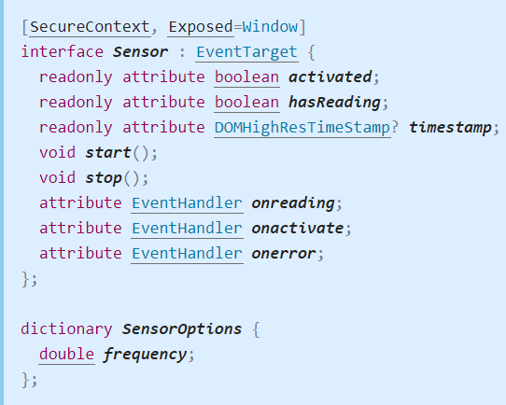
What Is It?
Demos: http://bit.ly/GS-API
The Generic Sensor API is a standard built to promote consistency in exposing sensor data to the Web.
This API is a W3C Working Draft, which means the specification isn't stable and we may expect some changes in the future.
Notes:
The Generic Sensor API is an interface created to promote consistency in exposing a device’s sensor data to the Web.
Device sensors allow us to extract data from our environment for use in our webapps. The API provides us with a consistent interface when attempting to access our devices’ sensors.
This API is a W3C Working Draft, which means the specification isn't stable and we may expect some changes in the future.

Slide 3
Popular Use Cases
Demos: http://bit.ly/GS-API
Modern mobile devices, and web browsers implement several sensors:
Environmental Sensors | Ambient Light Sensor, Proximity Sensor, Magnetometers | Home Automation, Accessibility, Fitness Monitoring, Weather Monitoring
Inertial Sensors | Accelerometers, Gyroscopes | Immersive Gaming, Indoor Navigation Systems, Activity Tracking, 3d Scanning
Fusion Sensors | Device Orientation Sensors, Gravity Sensor, Linear Acceleration Sensor | ∞
Notes:
Modern mobile devices, and web browsers implement several sensors for us to access.
These sensors fall into 3 categories:
Environmental Sensors (Ambient Light Detectors, Proximity Sensors, and Magnetometers) provide information about the environment. Applicable domains: Home automation, accessibility, and fitness monitoring.
Inertial Sensors (Accelerometer and Gyroscope) provide information about forces applied to the device. Applicable domains include: Virtual Reality Gaming, Indoor Navigation Systems, 3d Scanning,
Fusion Sensors (Absolute Orientation Sensor, Gravity Sensor, Linear Acceleration Sensor) are created by combining the readings of two lower-level sensors into one. Linear Acceleration Sensor is composed of the Accelerometer, Magnetometer, and Gyroscope and can be used to detect whether your phone is falling, or if your car is moving without having to do the math.

Slide 4
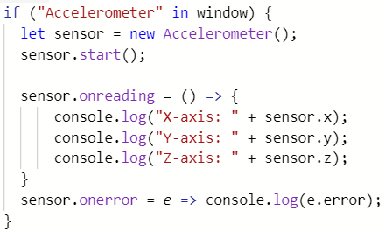
Implementation
Demos: http://bit.ly/GS-API
Feature Detection
Create the Sensor
Start the Sensor.
Subscribe to Events.

Slide 5
Security Risks
Demos: http://bit.ly/GS-API
Location Tracking (Accelerometer, Magnetometer, Ambient Light Detector)
Key Stroke Monitoring (Gyroscope, Accelerometer)
PINLogger.js
Device Finger-Printing (Multiple Sensors).
Notes:
Sensors pose a big risk as they provide high level information about a user’s habits.
Location tracking can be performed using only a few sensors. A malicious website can use map-matching algorithms to infer the location of a smartphone using statistical models generated by data collected by the Accelerometer and Magnetometer.
PINLogger.js was a study done which discovered that through use of the Gryscope and Accelerometer sensors they were able to guess a user’s pin numbers just based off the forces you apply when typing in your pin number.
Websites can create fusion sensors that can aggregate data from multiple Environment sensors to identify you. Temperature, Barometer, and Magnetometer sensors can be enough to pinpoint your exact longitude and latitude.

Slide 6
Inconsistencies & Limitations
Demos: http://bit.ly/GS-API
Browser Limitations:
Requires Secure Context (https://)
Requires focus on element or page using sensor readings.
Require a user prompt requesting additional permissions.
Not all browsers implement (Opera)
O.S. Inconsistencies:
Different environments may interpret sensor readings differently. (Inverted Gyroscope Axis on some iPhones)
Notes:
In order to mitigate some of the risk associated with exposing your devices sensor data to the web, W3C has imposed some restrictions to the data’s usage.
Limitations include requiring a user to be in a secure context before providing sensor data, requiring user’s focus on the window currently requesting access to a Sensor, additional permissions may be required when accessing sensor data.
It's also worth noting that this API has some known inconsistencies in several browsers and on a number of operating systems.

Slide 7
Sources:
Demos: http://bit.ly/GS-API
W3C's Generic Sensor API: https://www.w3.org/TR/generic-sensor/
W3C's Generic Sensor Use Cases: https://w3c.github.io/sensors/usecases Stealing PINs via mobile sensors: (PINLogger.js) https://rd.springer.com/article/10.1007/s10207-017-0369-x?wt_mc=Internal.Event.1.SEM.ArticleAuthorOnlineFirst
Additional Readings & Examples: https://modestduck.com/generic-sensor-api/
Notes:
In order to mitigate some of the risk associated with exposing your devices sensor data to the web, W3C has imposed some restrictions to the data’s usage.
Limitations include requiring a user to be in a secure context before providing sensor data, requiring user’s focus on the window currently requesting access to a Sensor, additional permissions may be required when accessing sensor data.
It's also worth noting that this API has some known inconsistencies in several browsers and on a number of operating systems.

